Slide 1


`````
Varsha Dwajan
Sai Tadimeti
Soumya Veer
Sharath Chandra
Sriteja Aluri
Sriram Gorantla

Slide 2
contents
Introduction
Design Description
Development
Company Budget
Challenges
Video
Scope for further development
Acknowledgements

Slide 3

The problem
Extensive wait time at the laundry facilities (public and community based)
Inconvenience of carrying coins to operate machines

Slide 4
Who Are We?
E-wash is a company that has automated a queuing system.
Our technology can be generalized to cater large masses.
We have focused on the laundry system.
We not only save your money but also time!

Slide 5

Our Mission
We aim to integrate modern technology with the currently existing infrastructure to provide better customer satisfaction by
Reducing Wait-time to access washing machines
Eliminating the usage of coins
Streamlining the machine maintenance process

Slide 6
The business idea
Users Register for our services
Users can login and book slots
User accesses the machine using RFID

Slide 7

features
Booking a slot
Cancelling a slot
Recharging the account online using various payment options

Slide 8






Design Technologies

Slide 9
Justification of choices
Decisions which we made…..

Slide 10
Software
JSP for Webpages
One of the users has prior working experience
One of the users has Java certification
Apache Tomcat
JSP works with Apache Tomcat
MySQL
Open source

Slide 11
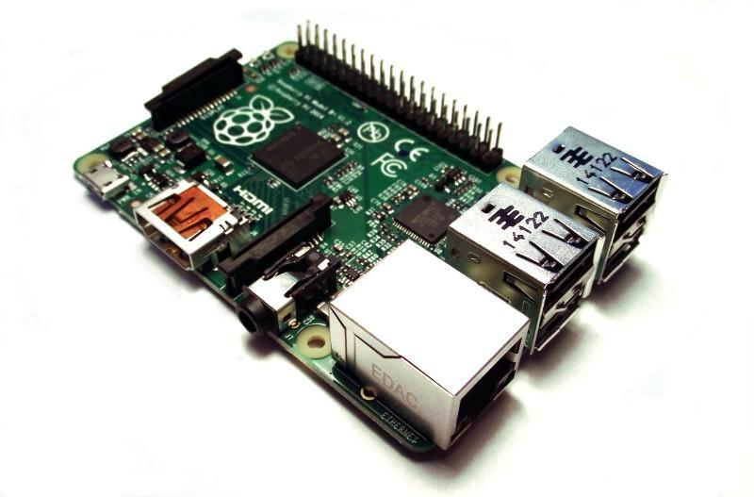
Hardware
Raspberry Pi B+
It is a micro-computer which runs Raspbian OS – A Linux Flavor
Enriching the learning experience – New Hardware
4 USB 2.0 Ports, Wi-Fi capability, Ethernet, 512MB RAM
Compact form factor
720p HDMI output
Uses Python as a native language for programming

Slide 12
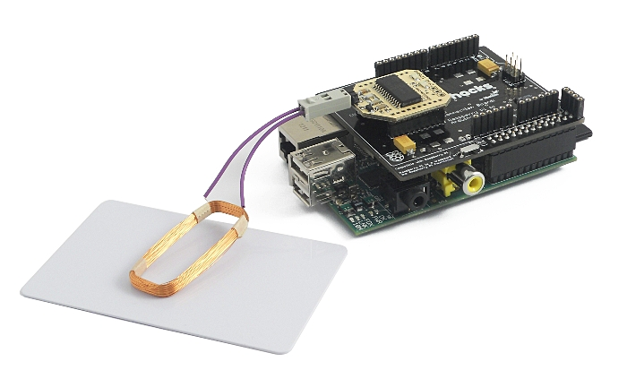
hardware
Cooking Hacks 125 kHz RFID module
Built for the Raspberry Pi
Uses well acquainted Arduino language for interface
Future expansions on the shield possible
Good online user community and customer support

Slide 13

Software development
Smell the ‘coffee’….

Slide 14
MyAccount Page
Home Page
Myaccount Login Page
Forgot Password
Make Appointment
Authentication failed
Confirm Appointment page
Create Account
Time out page (Pop up page)
Payment Page
Cancel Appointment Page
Pay Pal

Slide 15
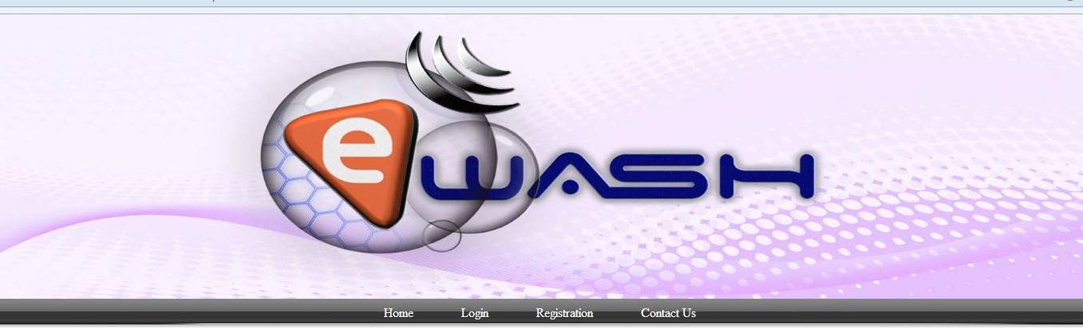
Graphical User Interface Home PAge

Slide 16
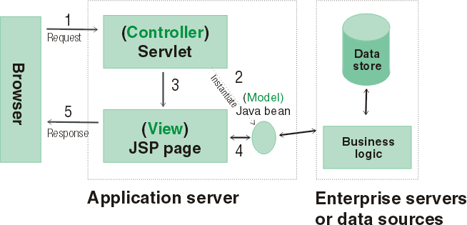
Model View Controller
Front End(View): User interact with JSP, deployed in Apache Tomcat Server.
Servlets (Controller): They do the business logic. Interact with database and do the transactions and Request dispatch the Jsps.

Slide 17
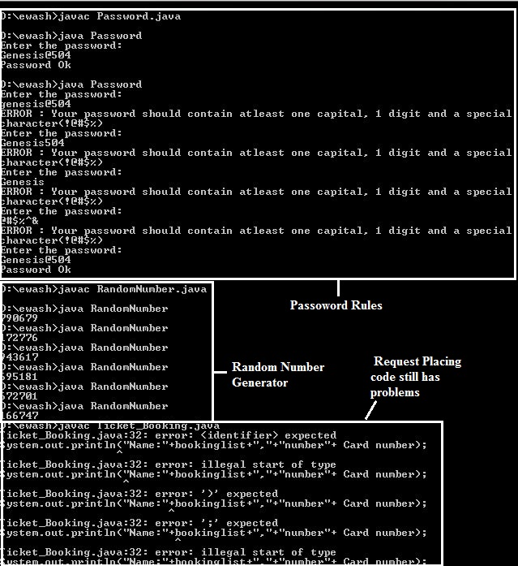
JAVA CODE

Slide 18
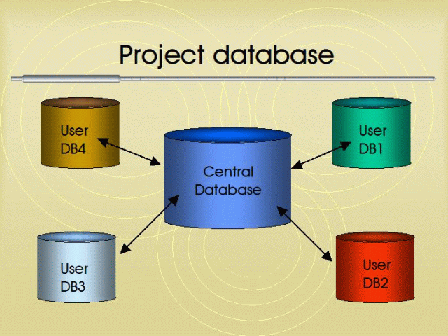
Getting Started with Databases
MySQL is a very popular, open source database.
It handles very large databases, gives very fast performance.
SQL is a structured language for querying multiple databases.
The main part of SQL is retrieving and performing operations on data.
Easy to use with other software's using connectors like JDBC, mysqldb to connect
to Java and Python.

Slide 19
OTHER KEY FEATURES OF MYSQL:
Commercial version of MySQL is also provided. Users can choose to use the MySQL software as an Open Source product or Most widely used is open type.
MySQL software delivers a very fast, multi-threaded, multi-user, and robust SQL (Structured Query Language) database server.
MySQL is a open source relational database management system and works in client/server or embedded systems.

Slide 20
Creating and using JDBC Application:
Steps involved in building a JDBC application to interact with JAVA program:
1) Import the packages
2)Register the JDBC driver
3) Open a connection
4) Execute a query
5) Extract data from result set
Similarly, mysqldb connector is used to a connector for Python to interact with MySQL database.

Slide 21
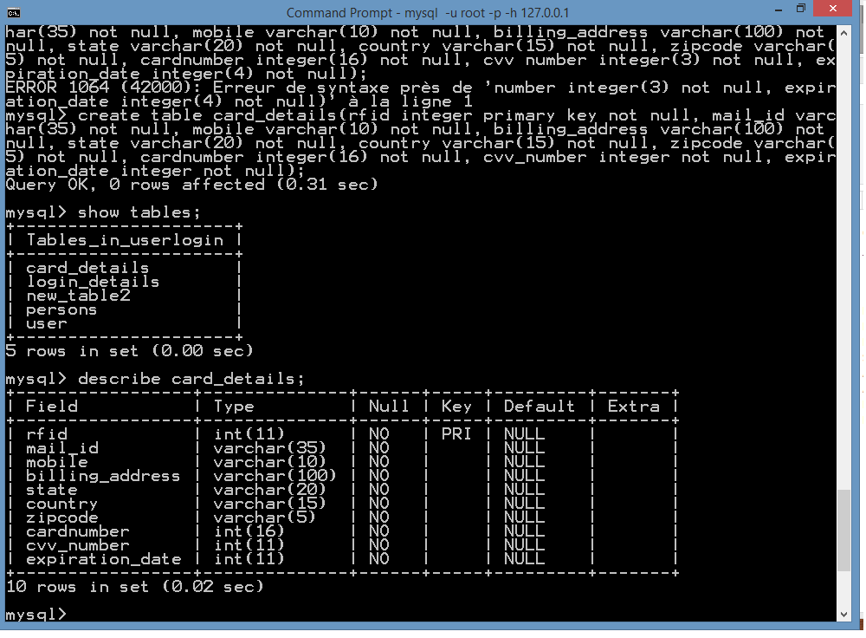

Slide 22
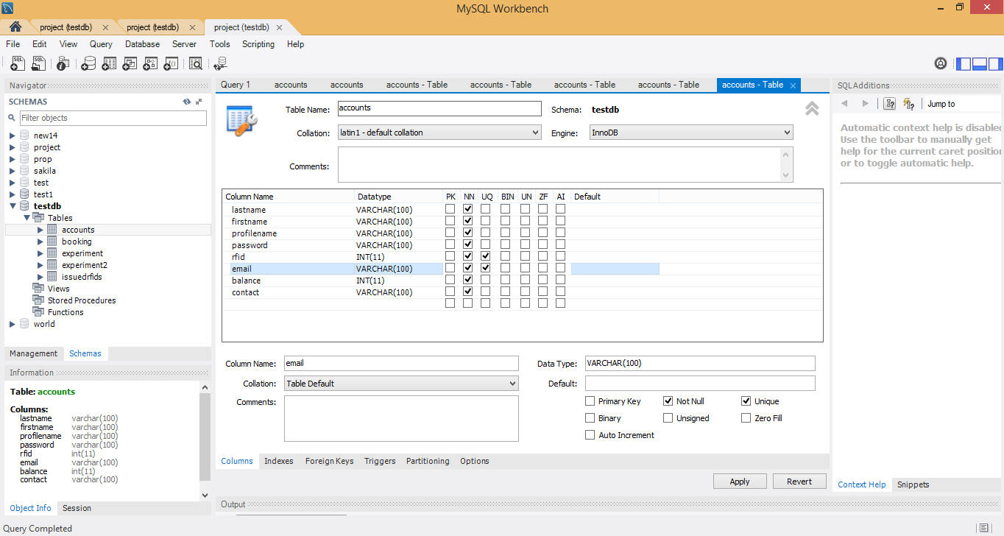
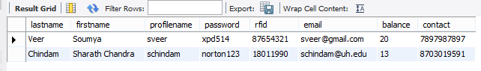
Creating a table in database using MySQL Workbench:

Slide 23

Hardware development
The recipe..

Slide 24

RFID TAG
RFID CARD
Pi
SERVER
READER
(
Python
)
HARDWARE SOFTWARE HANDSHAKE
DATABASE
(
MySql
)
GUI

Slide 25
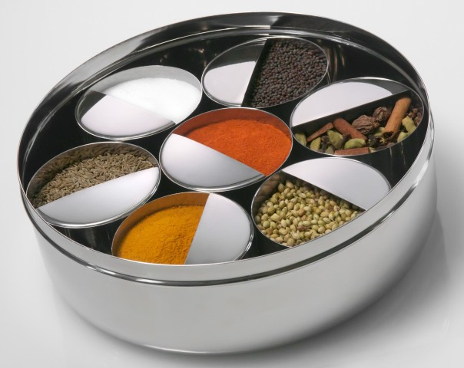
THE INGREDIENTS
Reading the RFID card
Python – MySQL database linkage
Python File Access
Executable bash file

Slide 26
Component Budget
Name of the item | Quantity | Cost Incurred
Raspberry Pi B+ | 1 | $60
720p 19” HDMI Screen | 1 | $60
RFID module | 1 | $60
Module – Raspberry Pi bridge | 1 | $30
RFID Tags | 5 | $2
Keyboard | 1 | $10
 | Total | $222

Slide 27
Labor and other costs
At the rate of $50/hour…
10 hours/week…
12 weeks..
6 people…
The Labor Costs amount to $36,000
Promotional Cost [Radio, Posters, Flyers] : $2000 - $3000

Slide 28


challenges
A Struggle? Or a Learning Phase??

Slide 29
Software challenges
Establishing connections with databases
Remote database configuration
Installing and configuring MySQL server for tests
Adobe Photoshop learning curve for Logo Design

Slide 30

More software problems…..
JSP codes for webpage linkages and database operation [including scheduled service executer]
Choice of Web-development software [From Webflow to Dreamweaver]
Apache Tomcat environment
Idea of Enterprise Java Beans had to be scrapped
Network connectivity issues while starting the server up

Slide 31

Hardware challenges
Setting up the Raspbian environment
Installing support packages
Initial network setup
Learning Python
Configuring the RFID shield
Configuring Python to access databases – Incompatibility between IDLE and MySQL

Slide 32
The video
Behold….
Notes:
Scheduled Service Executer: We execute the bash file which changes the status in the table, indicating that user’s request has been serviced. This is when Service Schedule Executer starts working . It searches or status zero entry , matches the RFID, deducts the Cost and updates the table . Finally deleting the table entry with status zero.

Slide 33
Scope for further improvements
Community/Housing Login development
Text message/e-mail alert services for the customers
Cancelling and Rescheduling appointments based on timestamp
Restricting access to machines based on timestamp

Slide 34
Acknowledgement
Professor Yuhua Chen
Cullen College of Engineering
College of Technology
Brisk Home Solutions
Rimmi Patel – Graduate Student, Computer Science Department
Chaitanya Uppaluri – Graduate Student, Computer Science Department
Kavya Yerrabandi – Graduate Student, Electrical Engineering Department
Sagar Shivaram - Graduate Student, Electrical Engineering Department

Slide 35
Questions?
Your Comments/Feedback is much appreciated

Slide 36

THANK YOU!!
We appreciate you for your patience….

